Slide 1
Middleton Primary School
Governing Body Information
Notes:
1

Slide 2
The Role of the School’s Governing Body
School governors are individuals who want to make a positive contribution to children’s education. They are responsible for overseeing the management side of a school: strategy, policy, budgeting and staffing.
They enable their school to run as effectively as possible, working alongside senior leaders and supporting teachers to provide excellent education to children.
Being a school governor is a commitment to attending governing body meetings which consider issues such as setting the school vision, mitigating financial risk and scrutinising educational outcomes. They are also involved in the school community, acting as critical friends to the headteacher and senior leaders.
Governors bring a wide range of skills and expertise from their professional lives to the governing board and schools benefit greatly from working with skilled volunteers, for example individuals with experience of finance, law, premises management or human resources. A governor with business know-how can transform the running of a school.
Notes:
2

Slide 3
What Does the Governing Body do?
The Local Governing Body works very closely with the Headteacher and School’s Senior Leadership Team to ensure the very highest quality of teaching and learning throughout the school.
They have strategic oversight of the school’s development and act as a critical friend to the school’s work.
The core duties of the Local Governing Body are:
Ensuring clarity of vision, ethos and strategic direction.
Holding the Headteacher to account for the educational performance of the school its students.
Overseeing the financial performance of the school and making sure its money is well spent.
Ensuring the highest standards of teaching and learning.
Ensuring the highest standards of safeguarding and welfare.

Slide 4
Who are the School’s Governor's?
The School’s Governor's currently consist of the following individuals;
Sam Summers – Chair of Governors
Tony Holland - Vice Chair Governors
Peter Neale – Governor
Barbara Bushell - Governor
Tania Foreman - Governor
Tina Gray-Rampello – Parent Governor
Rachel Roberts – Headteacher Governor
Tara Trail – Staff Governor
Liam Beaumont – Staff Governor
Julie Mason - Clerk to the Local Governing Body
Peter Barnes - CEO of the Kingsbridge Educational Trust (KET) and Accounting Officer

Slide 5
Governor roles
Child Protection and Safeguarding Governor - Sam Summers
Mental Health & Well-being Governor Sam Summers
SEND Governor - Sam Summers
Looked After and Inclusion Governor - Sam Summers
Pupil Premium - Tina Gray-Rampello
Outcomes - Tina Gray-Rampello
Health & Safety - Peter Neale
Governor Development - Tony Holland

Slide 6
The Governing Body devolves some of its work to two committees; Finance & Personnel Committee and Pupil, Pastoral & Curriculum Committee. All key decisions are still ratified by the full Governing Body.
The members of each committee are as follows;
Finance & Personnel Committee:
(Clerk: Julie Mason)
Peter Neale (Chair)
Sam Summers
Tania Foreman
Tara Trail
Rachel Roberts
Also in attendance: Monica Elliott-Cirigottis
Pupil, Pastoral & Curriculum Committee:
(Clerk: Vicky Reeves)
Tony Holland (Chair)
Barbara Bushell
Tina Gray-Rampello
Rachel Roberts
Tara Trail
Also in attendance: Steve Hughes; Ellis Higgs

Slide 7
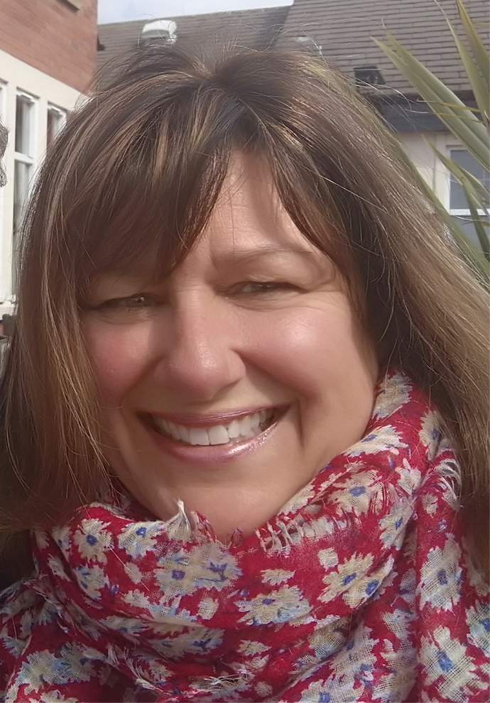
"I have been a Governor at Middleton Primary School since before it opened in 2003 and have been chair for the majority of that time. More recently my involvement has extended to becoming a Director of the Kingsbridge Educational Trust.
I have worked as part of the Senior Leadership in a School for a number of years so have an excellent insight into the operational elements as well as experience in the strategic management of schools.
Both my boys were educated at Middleton and more recently at Oakgrove School and I am passionate about educational excellence, inclusion and​ in particular all children being offered the opportunity to achieve their full potential​.”
Sam Summers
Chair of Governors

Slide 8
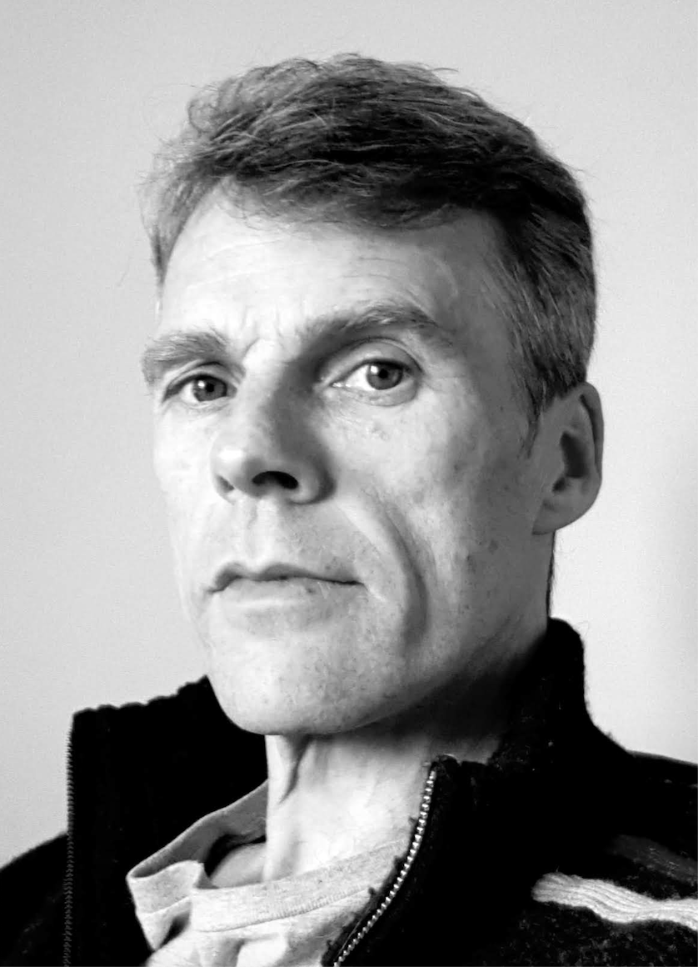
Tony Holland has spent the last 20+ years as a consultant for a large international technology company, where he currently works to achieve harmonisation between standards, both national and international, industry and with UK governmental policy and regulation. For a number of years Tony has also been the director of a Management Company operating in the property sector.
Tony has been a governor at Middleton since 2013 and has previously been subject link governor for curriculum subjects including Science, Art and Music, regularly reviewing these subjects with the subject leader from the school to monitor the quality and effectiveness of the subjects being taught. He is also the chairperson for the PPC committee and the vice-chair to the local governing body. Tony is a member of the Kingsbridge Educational Trust (KET) and was a participant in the initial establishment during the process when Middleton converted to an academy.
In July 2018 Tony’s son saw the end of his 7-year journey through Middleton and left to move on to Oakgrove to start his next educational chapter with strong SATs to support him, thanks to the commitment of the teaching staff at Middleton.
Tony Holland
Vice Chair of Governors

Slide 9
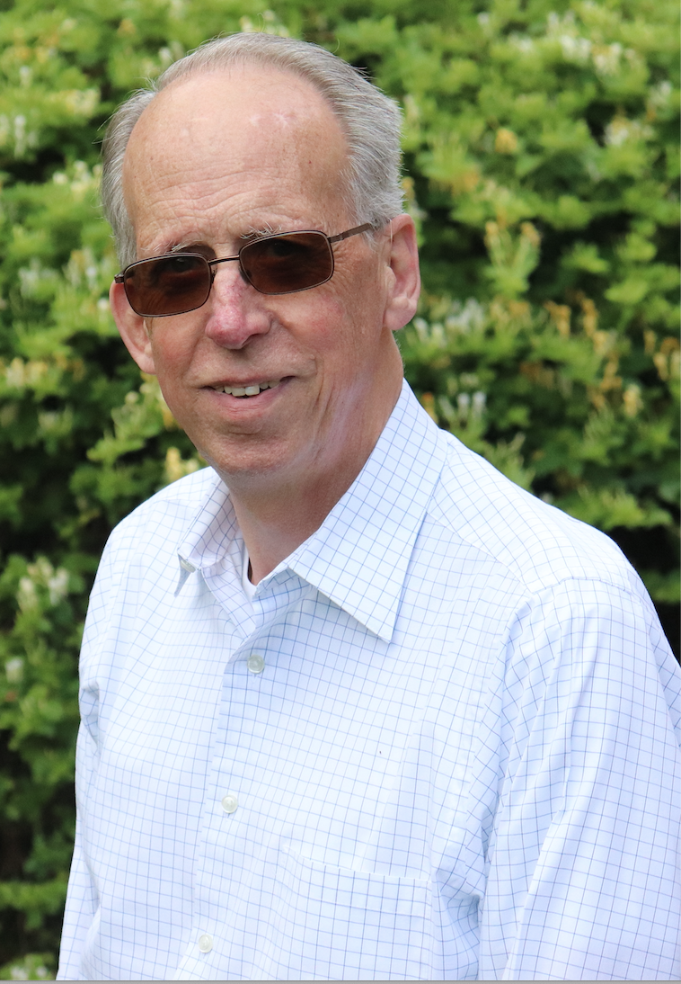
Educated as an Engineer, Peter served in the Army for 29 years and was a Civil Servant for 10 years. In both careers, he specialised in Information and Communications Technology (ICT), Project Management and leadership.
Peter and his wife, Liz, have lived in Middleton since 2000. After retiring in late 2011, Peter was recruited as a Governor for Middleton Primary School. He joined the Finance and Personnel Committee and became its Chair in March 2014.
Peter is the link Governor for Maths, Science and Year 2 and has a special interest in Health and Safety . Peter has no family connection to Middleton Primary School, but has 1 grandchild of primary school age, currently in Year 1, His sister is currently in Nursery and is about to move to "Pre-School" in January 2022. They both live in Salford Priors in the Vale of Evesham.
His 2 daughters are both teachers, one at an all-through Special School in Torquay and the other at a primary school in Worcester.
Peter Neale
Governor

Slide 10
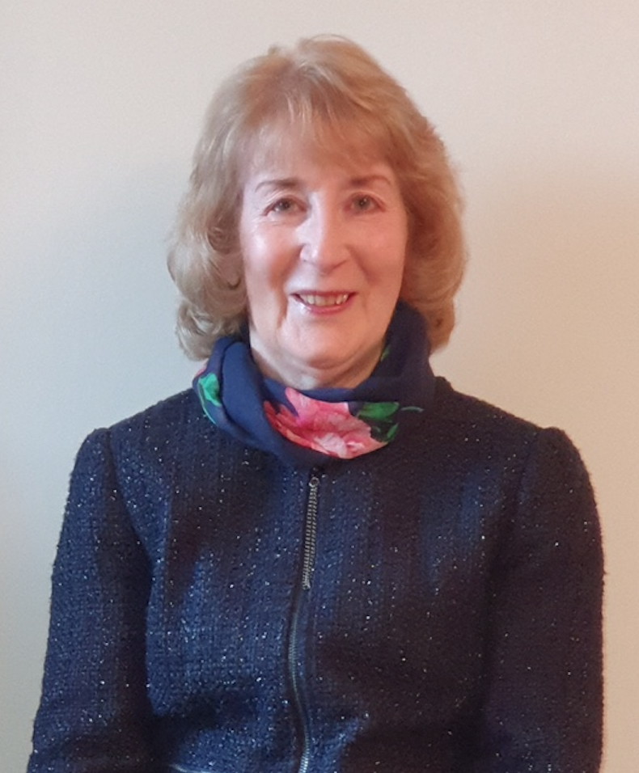
“After a short career in education, I joined the Civil Service where I spent 40 years before my retirement in 2017. During this time I worked in a number of government departments covering a variety of roles and held management positions in HR, National Insurance Inspectorate and Fraud. With lead responsibility for the introduction and implementation of government policies, I also oversaw the recruitment and training programmes required to deliver these new initiatives.
My latter years were spent supporting some of our most vulnerable members of society gain sustainable employment. I am passionate about education and the life chances that it brings so the opportunity to lead the Apprenticeship Programme was perhaps the most rewarding role of all. I worked in conjunction with local colleges and businesses mentoring youngsters in their journey to gain the qualifications that had eluded them during their earlier years of education.
I live in South Northamptonshire and have seen Milton Keynes develop from the initial concept to the outstanding city it has now become. My daughter is a teacher at Middleton and I have been a regular visitor to the school for the past 3 years hearing children read, participating in themed events and accompanying classes on external visits. I became a governor in 2019 and joined the Pupil, Pastoral and Curriculum Committee in 2020.”
Barbara Bushell Governor

Slide 11
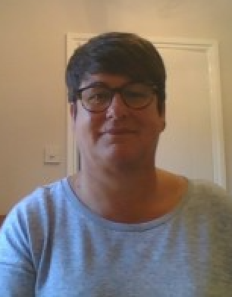
“I have lived in Milton Keynes since 1997 and currently work at the Open University supporting the Executive Dean in the Faculty of Business and Law. Prior to this, I have held non-teaching pastoral roles at Schools in the Milton Keynes and surrounding area. In these roles I have gained considerable experience in behaviour management, academic mentoring and safeguarding. I understand the challenges that students, parents and schools face and the importance of the home and school partnership.
On a personal note, I am married to Chris who I met more than 25 years ago whilst working in a HR role at Vauxhall Motors and studying for my CIPD qualification. My HR expertise covers all areas of HR including recruitment, monitoring sickness absence, providing support and guidance for disciplinary cases and training. We have a 21 year old son who has attended primary and secondary schools in Milton Keynes and is now at Loughborough University studying Economics.
I enjoy sport and have played hockey at an international level. I believe it is important for children to have the opportunity to not only fulfil their potential academically but in all other aspects of their lives. I also recognise the need for a balanced education which is engaging and fun for all students.”
Tania Foreman Governor

Slide 12
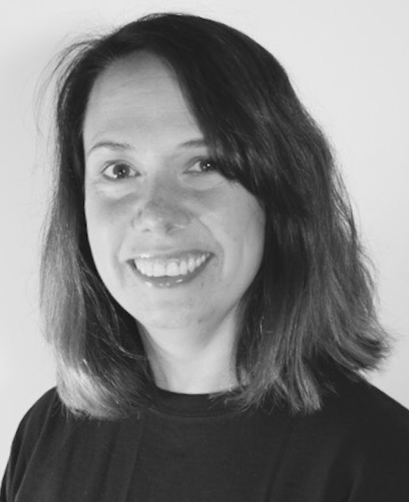
“My name is Tina Gray-Rampello and I currently have 2 children at the school. I have a thorough understanding of the education sector due to my career and have had experience of teaching and consulting in primary schools in various regions.
I currently work as a School Engagement Manager for the Royal Opera House Bridge supporting schools in engaging with creative and cultural learning across Hertfordshire and Bedfordshire. I am very passionate about children and young people having access to good quality arts and culture provision and the impact this can have on a child’s development. Within my role I support schools in curriculum design, Artsmark, CPD and networking with local and national cultural organisations.
In my spare time I enjoy spending time with family and friends, reading, studying, playing music and also work as a vocal coach at a local musical theatre academy.”
Tina Gray-Rampello
Parent Governor

Slide 13
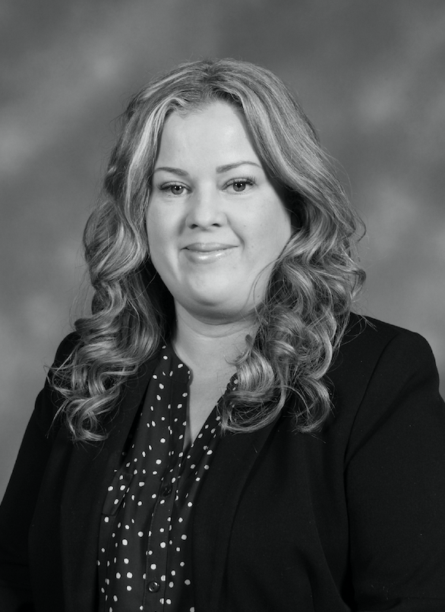
I am proud to be the Headteacher of Middleton Primary School, having previously been a teacher, Assistant Headteacher and Deputy Headteacher here.
Middleton has recently been recognised as an ‘outstanding’ school by OFSTED, a recognition we are thrilled with because it reflects the consistent hard work of all the children, staff, parents and governors.
I am very passionate about primary education being the foundations of success for our children. I am very ambitious for the future of Middleton and believe every child that comes to our school has the right to leave us completely equipped to enjoy the challenges of secondary education.
Rachel Roberts Headteacher Governor

Slide 14
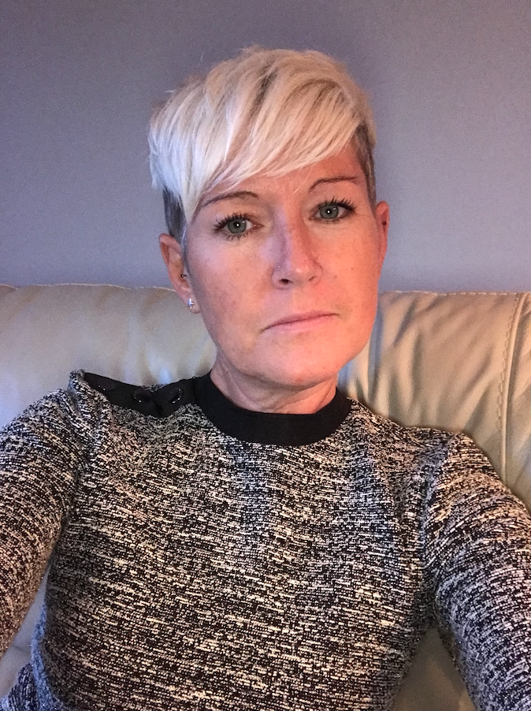
Tara graduated from a small teacher training college in Southampton with a B.Ed. hons degree with French. She began her teaching career at Streetfield Middle School in Dunstable, where she was a class teacher with responsibility for teaching French across the school.
She relocated to Exmouth when her first son, Sam, was a year old and taught at Whipton Barton Junior School in Exeter, where she continued to teach French but also discovered a passion for SEND and became the SENCO. After her second son, Joe, was born the family moved to Brittany, where Tara worked as an English language assistant in a French high school.
The family moved to Milton Keynes in 2005 and Tara has worked at Middleton ever since, teaching in various different year groups including EYFS and Year 6. Tara has led several subjects at Middleton including French, Geography and Global Education and her roles have included SENCO, Assistant Head and she is currently the Senior Deputy Head but maintains a teaching commitment.
Tara is an SLE for Special Educational Needs and has attained her NPQH qualification.
Tara Trail
Staff Governor

Slide 15
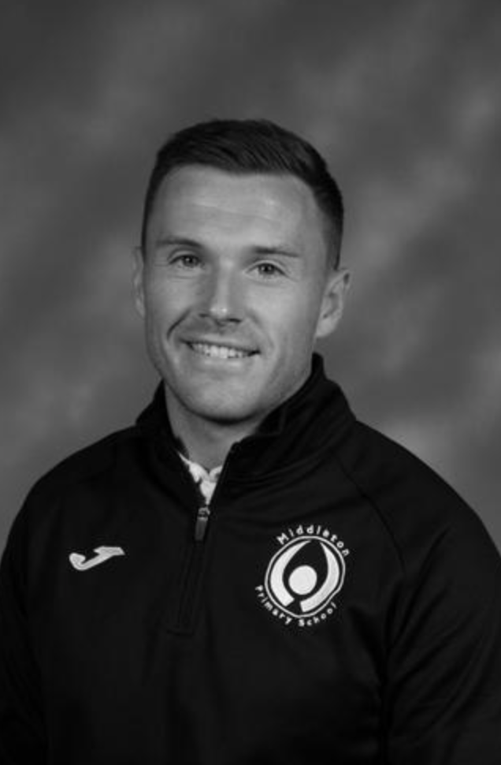
I originally joined Middleton as a Sports Coach having previously worked as an external sports club provider. During my second year at the school I completed my teacher training and am now the PE subject leader and manage the extended schools program.
You will usually find me outside teaching PE but I have also spent time teaching classroom based subjects when covering a long term absence.
I have spent a lot of time in my life being surrounded by Sport, whether that be playing or teaching/coaching. I believe that sport can be a tool used to develop not just physical skills but self-confidence, communication skills and wider learning behaviours that can be translated to all parts of life.
Our aim at Middleton is to give children a wide breath of opportunities enabling them to develop lifelong skills and enjoy different sporting activities.
As a school, we have been awarded ‘Milton Keynes Primary School of the Year’ 3 times in the last 4 years by the MK School Sports Partnership which recognises the work we have achieved in this area.
Liam Beaumont
Staff Governor

Slide 16
Further Information
To view a copy of the Register of Pecuniary and Business Interests please see below;
Register of Pecuniary and Business Interests
To view a copy of Middleton Primary School’s Local Governing Body Attendance for 2020-2021, please see below;
Local Governing Body meeting attendance 2020-21

